Slide 1
Security Technologies in Commercial Products
Dr. Glenn Wurster (gwurster@blackberry.com)

Slide 2
Overview
Access Control
Installing Applications
Malware Detection
Balancing Usability and Security

Slide 3
Access Control

Slide 4
Access Control Fundamentals
Control the ability for a subject to perform an action on an object.
Component | Description
Subject | The entity making the request. a process or user.
Action | The requested operation read, write, execute
Object | The target of the action a file, network connection, hardware

Slide 5
Purpose of Access Control
Limit the damage caused by:
Malicious applications
Malicious users
Compromised applications
Badly written applications
User mistakes

Slide 6
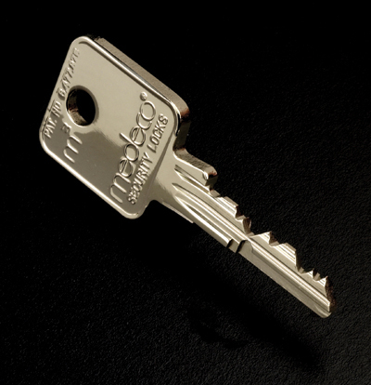
DAC and MAC
Discretionary Access Control (DAC)
Owner of an object has absolute control over permissions.
Mandatory Access Control (MAC)
Owner of an object can only set permissions in line with what the administrator allows.
Notes:
Apartment building keys that are not copyable – you have the key, but can’t create copies to give to your friends. It’s MAC.

Slide 7
Fine-Grained Access Control
Can be either DAC or MAC
Refers to the granularity of permissions
System wide?
Directory?
File?
Action on file?
Byte offset of file?

Slide 8
POSIX ACLs
A DAC scheme
File permissions based on the owner, group, and everyone else.
Owner can always modify permissions on the file.
# file: audio
# owner: gwurster
# group: audio
user::rwx
group::r-x
group:powerdev:r-x
mask::r-x
other::---

Slide 9
SELinux
A fine-grained MAC scheme developed by the NSA
Subject is composed of:
Who they are
The role they are playing
The domain they are operating in
Policy is set by the system administrator, and is in addition to the POSIX DAC.
http://www.selinuxproject.org
Notes:
Discuss role-based access control

Slide 10
SEAndroid
Use SELinux to confine Android applications
Extend SELinux to support Android features
Binder IPC
Calendar
Media Player
Game
http://selinuxproject.org/page/SEAndroid

Slide 11
AppArmor
A MAC scheme developed by Immunix
Each application has its own profile
Allows you to run the application and ‘learn’ the privileges it should have.
Operates based on file paths.
Notes:
Discuss difference between path and inode based access control.

Slide 12
Linux Capabilities
Is not capability based access control because privileges cannot be shared.
Designed to allow processes to drop root privileges.
Certain privileges were traditionally reserved for the root account.
Capabilities split the permissions given to root.
Notes:
Discuss capability based access control – can request and receive capabilities, can delegate capabilities to other processes.

Slide 13
Sample Linux Capabilities
Name | Description
CAP_CHOWN | Allow changing file ownership, overrides DAC
CAP_KILL | Send signals to other processes
CAP_NET_RAW | Allow using raw sockets (e.g., ping)
CAP_NET_BIND_SERVICE | Allow binding to ports below 1024
CAP_SYS_NICE | Allow raising process priority
CAP_SYS_TIME | Allow setting the system clock
linux-headers/include/linux/capability.h

Slide 14
QNX Abilities
Similar to Linux capabilities, but more advanced.
Can have allowed ranges
Whether the ability is inherited or not
Can be set differently for root and non-root processes.
http://developer.blackberry.com/native/reference/bb10/com.qnx.doc.neutrino.lib_ref/topic/p/procmgr_ability.html

Slide 15
Sample QNX Abilities
procmgr_ability(
0,
PROCMGR_ADN_NONROOT|PROCMGR_AOP_ALLOW|PROCMGR_AID_SPAWN_SETUID,
PROCMGR_ADN_NONROOT|PROCMGR_AOP_SUBRANGE|PROCMGR_AID_SPAWN_SETUID, (uint64_t)1000, (uint64_t)1050,
PROCMGR_ADN_NONROOT|PROCMGR_AOP_SUBRANGE|PROCMGR_AOP_LOCK|PROCMGR_AID_SPAWN_SETUID, (uint64_t)2000, (uint64_t)2013,
PROCMGR_ADN_ROOT|PROCMGR_AOP_DENY|PROCMGR_AOP_LOCK|PROCMGR_AID_EOL
);
http://developer.blackberry.com/native/reference/bb10/com.qnx.doc.neutrino.lib_ref/topic/p/procmgr_ability.html
Notes:
Allow a non-root process to set the UID to 1000-1050 and 2000-2013 when spawning. Remove all other abilities when running as root and lock further changes as well.

Slide 16

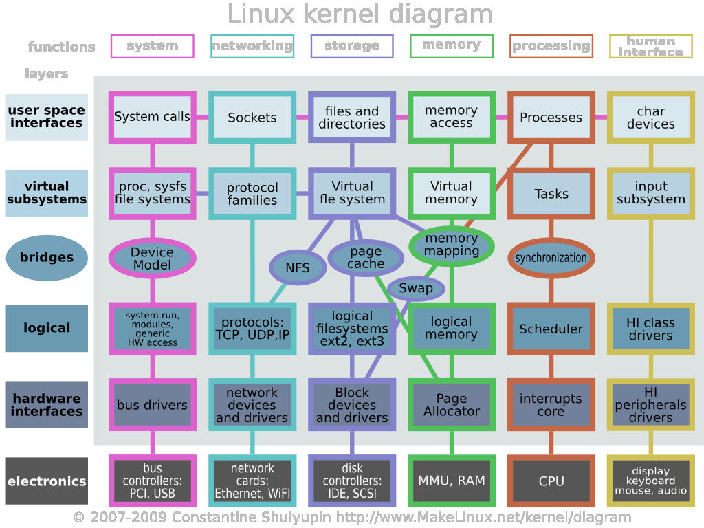
A Thesis Moment
Access control systems rely on the kernel
Notes:
To protect the kernel:
Reduce the interfaces that can be used
Reduce the code that can be attacked in the kernel

Slide 17
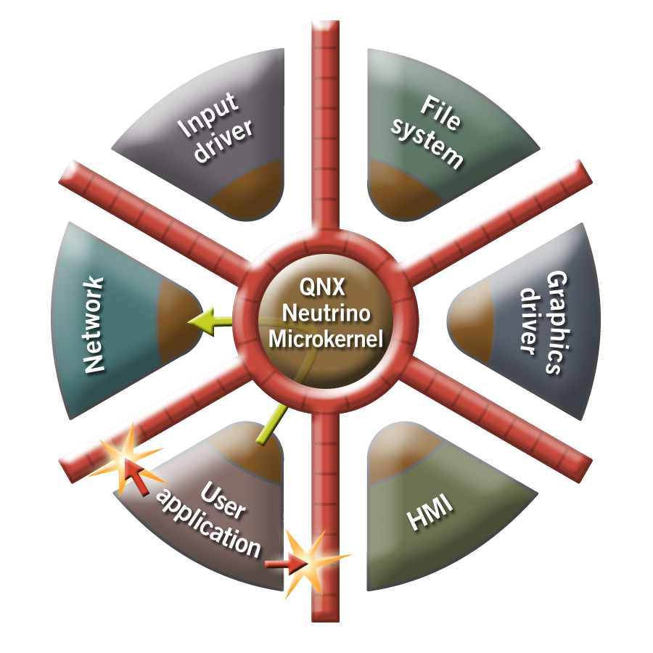
A Post-Thesis Moment
Reduce the size of the kernel, and you reduce the risk.

Slide 18
Installing Applications

Slide 19
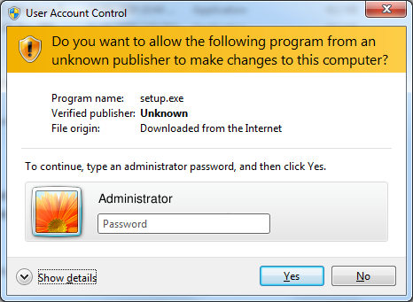
Installing in Windows
Become Administrator and run some downloaded code.

Slide 20
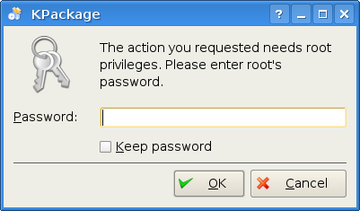
Installing in Linux
Become Root and run some downloaded code.

Slide 21
Installing in Android
Confirms that the user accepts all permissions.
Places the application package in a directory.
Allocates a UID and GID.
Creates a local data directory protected by POSIX ACLs
Notes:
Mention SEAndroid

Slide 22
Updating in Android
Updates are restricted by signing keys
Android applications are signed by the developer
Application v1.0
Application v1.1
Public Key
Public Key
Digital Signature
Digital Signature
http://developer.android.com/tools/publishing/app-signing.html
http://dx.doi.org/10.1109/TSE.2011.7

Slide 23
Installing in BlackBerry 10
Unpacks the application package in a directory.
Allocates a UID and GID.
When the application is run
Asks for permissions.
Creates a data directory protected by POSIX ACLs.

Slide 24
Installing in iOS
Each app is placed in a sandbox at install time
All code run on a production device must be signed by Apple.
Signing check happens when a code page is loaded into memory.
Code is signed as a result of being approved and distributed through the App Store.
http://www.mdsec.co.uk/research/iOS_Application_Insecurity_wp_v1.0_final.pdf
Notes:
Sandbox uses TrustedBSD MAC

Slide 25
Application Stores
Platform | Number of Stores
Android | Many
BlackBerry BB10 | One
BlackBerry Java | Many
iOS | One
Windows | Many
Notes:
Steam is an example of an alternate store for Windows.

Slide 26
A Thesis Moment
Looked at restricting application install on Linux
Install scripts were modified to run as a restricted user.
Looked at restricting upgrades
Introduced the model before it was announced for Android

Slide 27
Malware Detection

Slide 28
What is Malware?
Disrupt computer operation
Gather sensitive information
Gain access to private computer systems
http://en.wikipedia.org/wiki/Malware

Slide 29
Is it Malware?
Dynamic analysis
Run the program and see what happens
Static analysis
Deconstruct the program to see what it would do

Slide 30
What do Companies Use?
Companies do not want to give information about how their analysis works.
Company | Static Analysis | Dynamic Analysis
Google | ⬧ | 
BlackBerry | ⬧ | ⬧
Apple | ⬧ | ⬧
McAfee | ⬧ | ⬧
Symantec | ⬧ | ⬧
Microsoft | ⬧ | ⬧

Slide 31
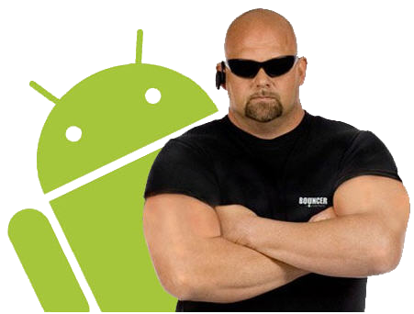
Google Bouncer
A dynamic analysis approach
Runs the application in a virtual machine
Hacked by Jon Oberheide and Charlie Miller
Submitted an application that phoned home.

Slide 32
Usability and Security

Slide 33
Passwords – The Good
Easy to learn how to use
Efficient to use
Accessible for disabled users
Negligible cost per user
Mature
Non-proprietary

Slide 34
Passwords – The Bad and Ugly
Written on post-it notes
Same password for several accounts
Rely on password recovery
Can be shoulder-surfed
Poorly chosen
Not resilient to phishing
http://research.microsoft.com/apps/pubs/?id=161585

Slide 35
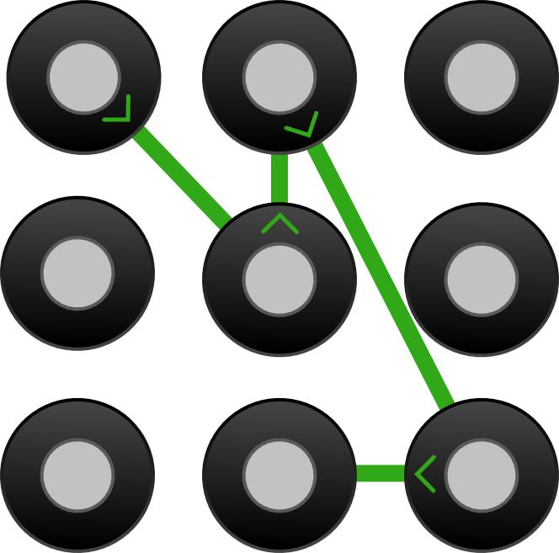
Alternative - Android
Equivalent to a 3 character alphanumeric password
20 guesses before device is locked
Notes:
Need to unlock a locked device by logging into the Google account tied to the phone.

Slide 36

Alternative - PassPoints
Click ordered # of points to authenticate
1
2
3
5
4
http://clam.rutgers.edu/~birget/grPssw/susan1.pdf

Slide 37
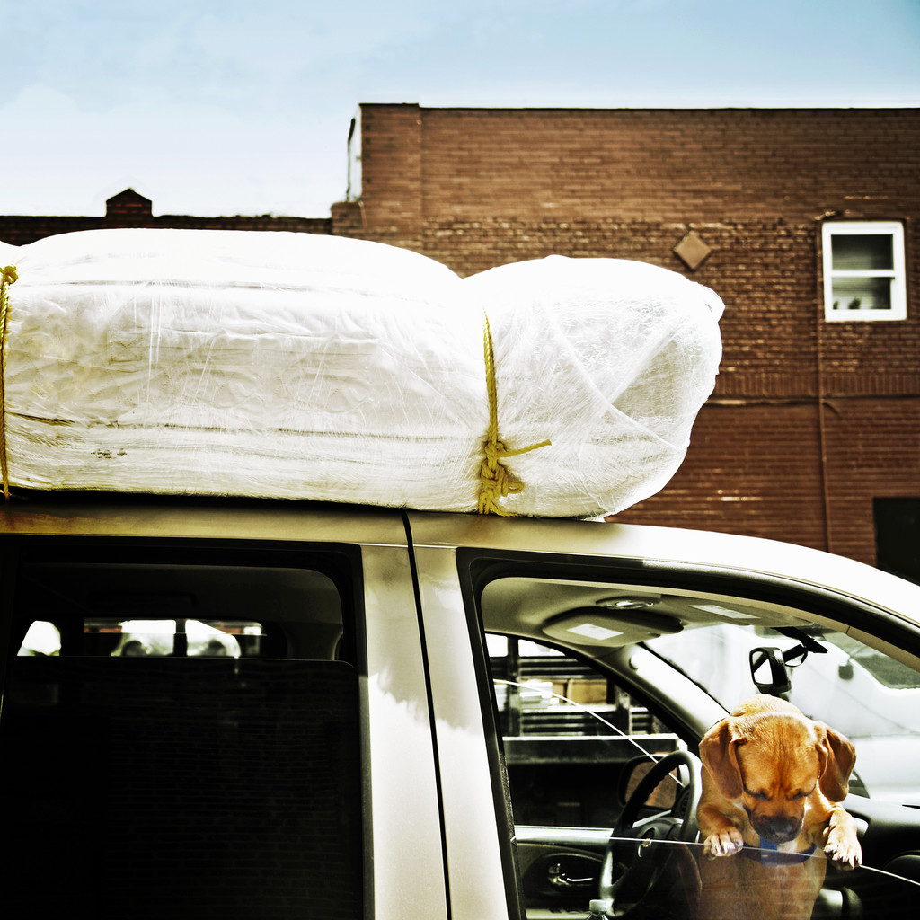
PassPoints – Now You Try!
Notes:
Patterns:
left-to-right
right-to-left
Locations:
Knot on top of the car
Diamond on the building
Intersection of vertical and horizontal pipe on the building
Middle of the window
Tip of the chimney
Dog’s Nose
Dog’s Paws

Slide 38
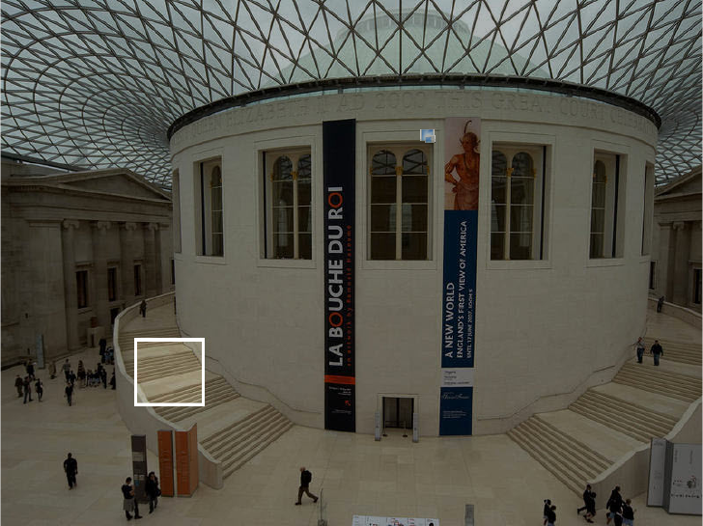
Alternative – PCCP
Persuasive Cued Click Points
http://www.scs.carleton.ca/~paulv/papers/pccp-tdsc-author.pdf
Notes:
Picture of the British Museum in London

Slide 39
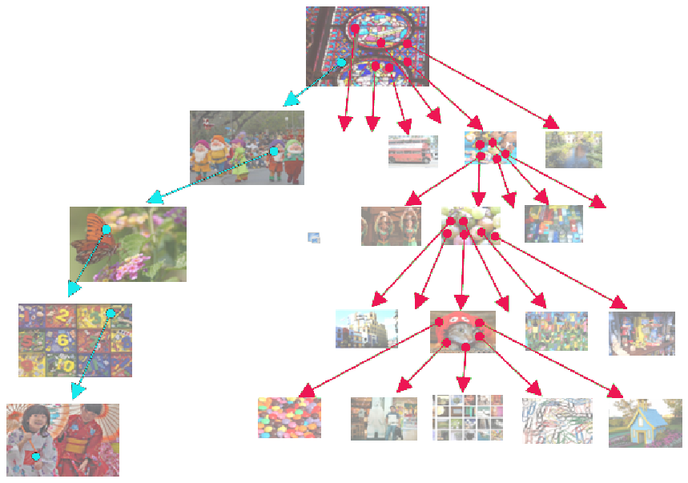
Alternatives – PCCP
Next picture shown depends on location of the click

Slide 40
Alternatives - Evaluation
Memorywise-Effortless
Scalable-for-Users
Nothing-to-Carry
Physically-Effortless
Easy-to-Learn
Efficient-to-Use
Infrequent-Errors
Easy-Recovery-from-Loss
Accessible
Negligible-Cost-per-User
Server-Compatible
Browser-Compatible
Mature
Non-Proprietary
Resilient-to-Physical-Observation
Resilient-to-Targeted-Impersonation
Resilient-to-Throttled-Guessing
Resilient-to-Unthrottled-Guessing
Resilient-to-Internal-Observation
Resilient-to-Leaks-from-Other-Verifiers
Resilient-to-Phishing
Resilient-to-Theft
No-Trusted-Third-Party
Requiring-Explicit-Consent
Unlinkable
http://research.microsoft.com/apps/pubs/?id=161585
Notes:
New is not necessarily better

Slide 41

Access Control
Users cannot correctly set policy.
Previous search for SELinux - how to disable it.
Fine-grained does not mean better

Slide 42
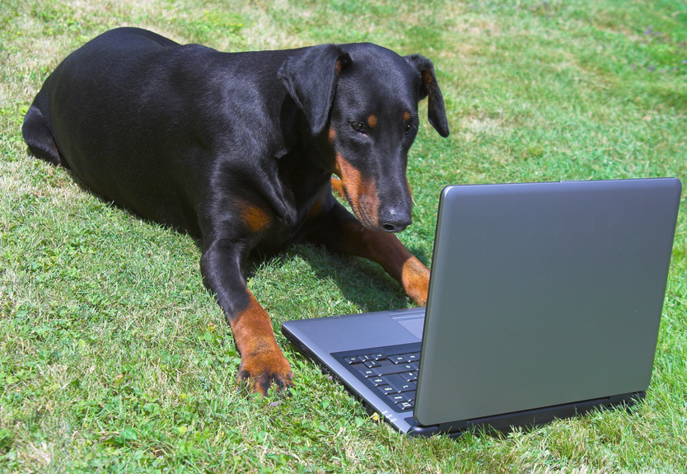
Improving Access Control
Who sets policy?
User
has not turned out well
System Administrator
often the user
Crowd sourced
community effort
Guardian
someone “in the know”

Slide 43
Application Permissions
Platform | Permissions | Denyable
BlackBerry Java | ~25 | 
BlackBerry QNX | ~15 | 
Apple iPhone | ~8 | 
Google Android | ~130 | ❒
Windows Phone | ~28 | ❒
Notes:
Android is the only one to split reads and writes of data
iPhone only does personal information (contacts, calendar, email) and location
BlackBerry Java contains different permissions for different networks
Windows phone (http://msdn.microsoft.com/en-us/library/windowsphone/develop/jj206936%28v=vs.105%29.aspx)

Slide 44

Separating Work and Personal
Separating work and personal life is easier said than done.
Notes:
How many have checked text messages while I’ve been talking?
How many have checked email?
How many classes have you missed because of a personal appointment?

Slide 45
Approaches to Separation
How do you separate work and personal information?
Approach | Overhead | Sharing | Display | Trusted Components
Two Devices | High | Manual | One at a Time | Air
Hypervisor | Moderate | Networks | One at a Time | Hypervisor, Hardware
Access Control | Low | IPC | Unified | Operating System, Hardware
Notes:
What is the difference between a hypervisor and operating system?
Hypervisor does not understand: filesystems, networking
Hypervisor pretends to be hardware, OS provides standard API that works across hardware.
Both have to deal with hardware
Hypervisors are traditionally smaller than monolithic kernels

Slide 46
A Thesis Moment
Developers are not experts at everything
Created a more restrictive policy for web applications
Content Type | Permissions
 | Fetch* | Read | Modify | Execute
Images |  | ⬧ | ⬧ | ❒
HTML |  | ⬧ | ⬧ | ❒
JavaScript |  |  |  | 
Styles |  |  |  | ❒
Audio/Video |  | ⬧ | ⬧ | ❒
http://wurster.ca/glenn/publications/ACM-CCS-2008.pdf

Slide 47

Questions?
Glenn Wurster (gwurster@blackberry.com)

Slide 48
Hypervisors

Slide 49
Life Before Hypervisors
Hardware
Operating System
Application
Application
Java Virtual Machine
Java Program

Slide 50
Bare Metal Hypervisor
Hardware
Hypervisor
Operating System
Operating System
Application
Application
Application
Application
Notes:
Also a type 1 hypervisor

Slide 51
Hosted Hypervisor
Hardware
Operating System
Hypervisor
Application
Application
Operating System
Application
Application
Notes:
Type 2

Slide 52
The Evolution of Malware

Slide 53
Identifying malware
Given one sample that we know is malware, can we detect it again?

Slide 54
In the Beginning
7469 2400 0061 625f 7373 655f 646e 5f5f
5f00 625f 7373 735f 6174 7472 5f5f 5f00
625f 7373 655f 646e 5f5f 5f00 7473 7261
0074 5f5f 7362 5f73 7473 7261 0074 5f5f
6e65 5f64 005f 655f 6164 6174 5f00 6e65
Detect malware by looking for specific sets of bytes

Slide 55
Avoiding the string match
7469 2400 0061 625f 7373 655f 646e 5f5f
5f00 625f 7373 735f 6174 7472 5f5f 5f00
625f 7373 655f 646e 5f5f 5f00 a5f9 7473
0074 5f5f 7362 5f73 7473 7261 0074 5f5f
6e65 5f64 005f 655f 6164 6174 5f00 6e65
Polymorphic code
Certain assembly instructions do nothing
and rax, rax
add rax, rbx sub rax, rbx
Certain instructions can be rearranged

Slide 56
Hiding the Binary
Executable Packers (e.g., UPX)
Encrypt the original binary
Decrypt only pieces of the binary as they’re needed for execution
Custom Virtual Machines
Write the malware for an emulated machine

Slide 57
Android Manifests

Slide 58
Android Manifest Permissions
<manifest ...>
<uses-permission android:name="android.permission.RECORD_AUDIO"/>
<permission android:name=“android.permission.NAME_FISH” android:protectionLevel=“signature” />
<application>
<activity android:name=".MainActivity”>
<intent-filter>
<action android:name="android.intent.action.MAIN" />
<category android:name="android.intent.category.LAUNCHER" />
</intent-filter>
</activity>
<service android:name=“com.example.fishtank.Tank” android:permission=“android.permission.NAME_FISH” />
</application>
</manifest>
http://developer.android.com/guide/topics/manifest/manifest-element.html

Slide 59
BlackBerry 10 Manifests

Slide 60
BlackBerry 10 Permissions
...
Application-Name: Test
Application-Description: The Test Application
Application-Version: 1.0.6.0
Application-Requires-System: BlackBerry 10/10.0.9.0
Entry-Point-Name: Permissions
Entry-Point: ... app/native/Test.so
Entry-Point-Type: Qnx/Cascades
Entry-Point-Icon: native/icon.png
Entry-Point-User-Actions: use_camera
Entry-Point-System-Actions: run_native

Slide 61
BlackBerry 10 Manifest Signing
...
Package-Author: Glenn Wurster
Package-Name: bb.gwurster.test
Package-Version: 1.0.6.0
Package-Architecture: armle-v7
Package-Author-Certificate-Hash: G1LSjYVDFDbQdBbLlMvB4DzemNeILxqQo6sSVJE7ssz1WoCpEWMNhHBuGjZYIuH5vmNkrD7jjvNmY_UInZQxfQ
Package-Author-Id: gYAAgIU_NLXhlghtmeALJDVELWU
Archive-Asset-Name: native/bar-descriptor.xml
Archive-Asset-SHA-512-Digest: JZ1frDUcJ4An7OKKS2iBfV__7-90tUaOrJX_O5N-lvE4l4wbHJuuOyyOPD--yYjM9C_WseY14hDMY9wawSw07g

